Slide 1
Hypertext assassins
DEEPANSHU (LEADER) SAURABH BISHT
PRAYAG SINGH PRITAM KUMAR

Slide 2
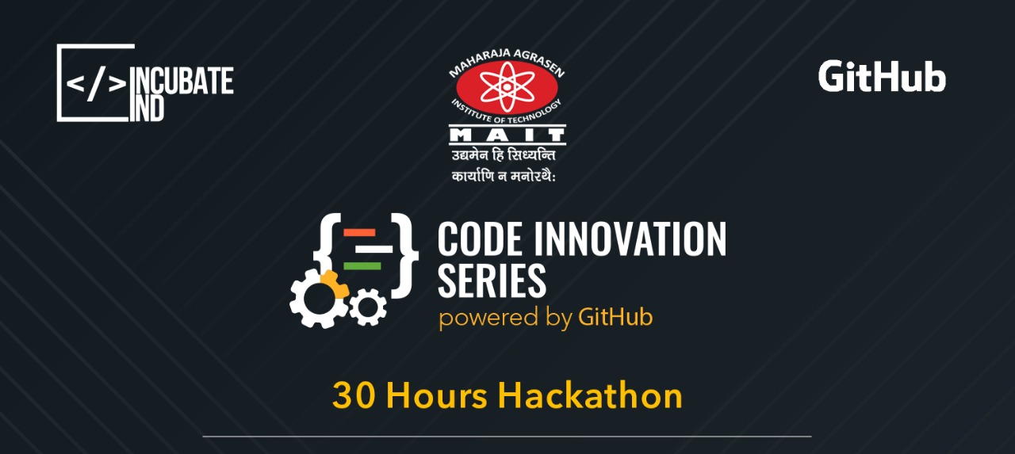
QATAAR
Sick OF WAITING FOR QUEUES? WE GOT YOU..

Slide 3



problem
PATIENT
CHECKUP
LONG QUEUES FOR REGISTRATION
Patients have to wake up early as most of the govt. hospitals make health cards between 6-10am.
Most of the time patients don’t have anyone to accompany them, in that situation standing in long queues becomes a tedious task.

Slide 4
SOLUTION
LONG QUEUES FOR REGISTRATION
CHECKUP
PATIENT
We will create a platform where patient can provide their information and our executive will go to the hospital and get the registration done for them.

Slide 5
WHY QATAAR?
Most of us have gone through this situation where we have to wait in long queues to get even a normal treatment at a govt. hospital. We curse the system and often make statements like take ₹ 100-200 but remove this process of waiting in queues.
When we go to a govt hospital we have to go to their OPD early morning get ourselves registered, & then they might refer us to some specific department according to our problem. And after that they will give us next date for checkups, procedures and all. Sound tiring already? Well add to it you cant miss your dates or otherwise you might have to undergo the whole process again. The toughest part is waiting in queues, & you are required to that every next day and it becomes even more tough if you don’t have anyone with you.
Here comes QATAAR in play, patient will register on our app and provide us detail. For eg department and all other personal details required for generating their health card. Our executive from nearby hub to that hospital would go to hospital and get all the registration process done. Meanwhile patients can check the status of whole process from their app.

Slide 6


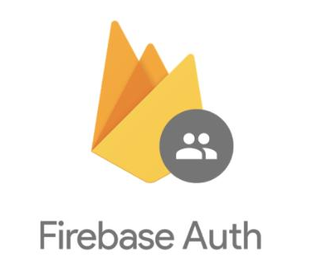


TOOL AND TECHNOLOGY USED
KODULAR.IO
FIREBASE
AIRTABLE
ONE SIGNAL
FLURRY BY YAHOO

Slide 7
THANK YOU

